Slide 1
Parking And Camera Violations in NY
Presented by: Akash Gandhi, Ketankumar Patel, Shashank Jengathe
Submitted to: Dr. Jongwook Woo

Slide 2
Table of Content
Introduction
What this project about
SDLC Implementation
Project Flow
Hortonworks Sandbox, Hive, Hue, Zeppelin, Putty(SSH client for windows), Tableau, Power BI
Hive QL
Conclusion

Slide 3
Introduction
Increase number of parking violations each year becoming nuisance to public safety department.
To provide quality of law enforcement services, prevention and detection of criminal activity, public safety department needs some technique.

Slide 4
What this project about
To avoid parking violations, we analyzed NY State parking violation data approximately of 860 MB size.
Through this analysis we populate all the relevant information about the dataset.
That displayed the analyzed in the form of maps & graphs.
Future prediction can be based on this data using analysis.

Slide 5
Data Specification
NY open source data for parking & camera violation
Data Size- 860 MB (.csv)
Offences- Double parking, No parking zone, Speed limit near school area, Expired meter etc.

Slide 6
SDLC Implementation
Planning
Determination of time, scope, requirement
Analysis
Data gathering & design solutions
Design
Selecting required S/W for implementation
Implementation
Project development & Documentation
Testing
Testing the final project &make changes required

Slide 7
Flowchart
Downloaded Dataset from NY public gov. dataset
Created Tables on HiveQL
Visualize data using Tableau & Power BI
Analyze data using Zeppelin
Uploaded data on Ambari

Slide 8
Data set
NY city open Dataset
MS Azure Sandbox

Slide 9
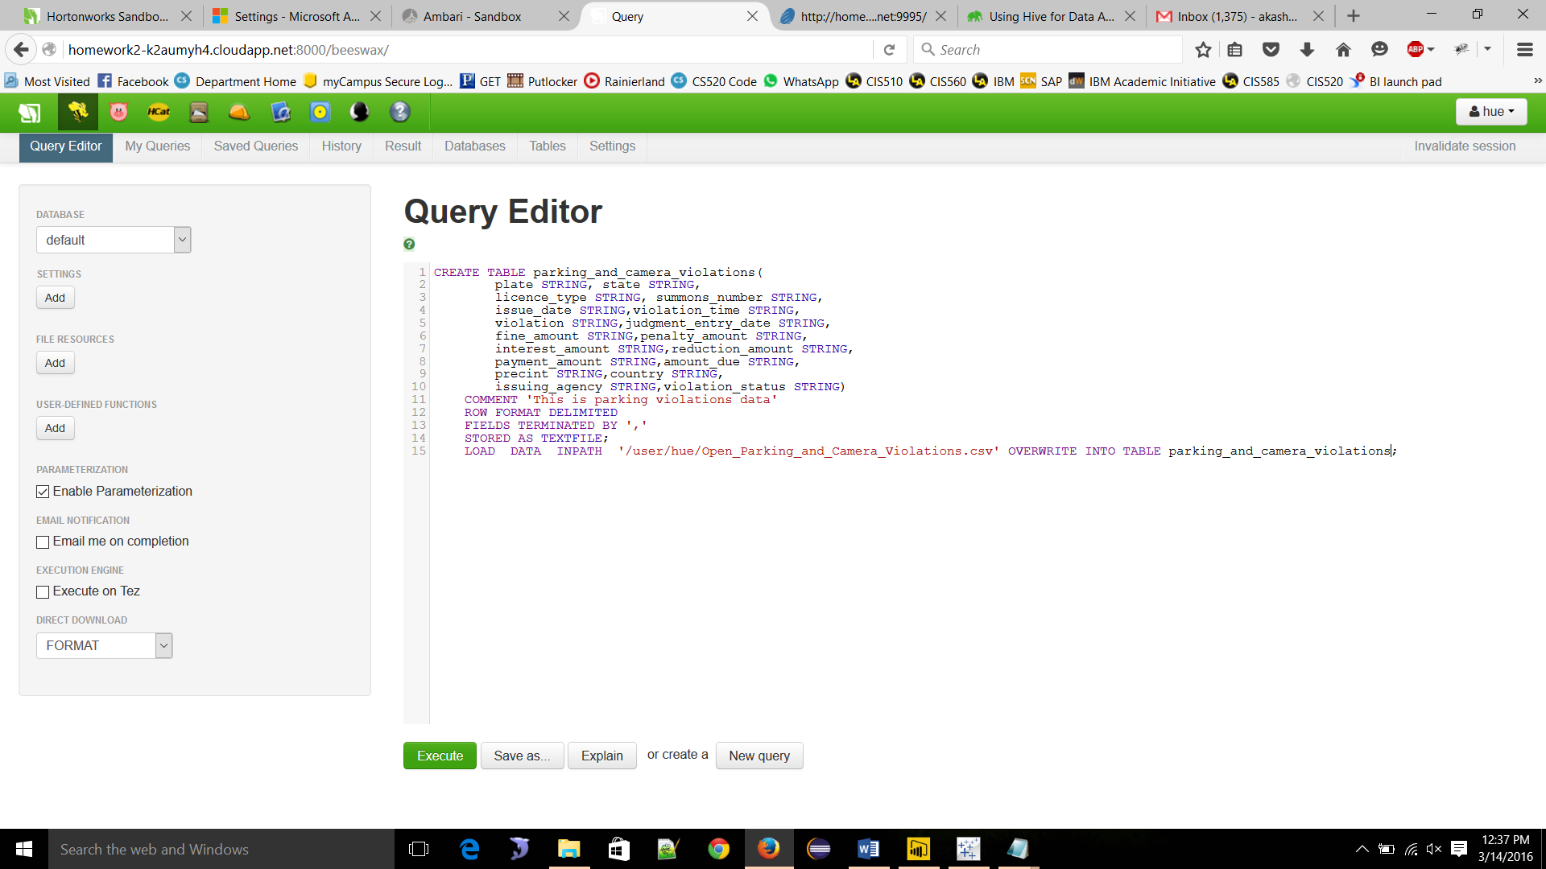
Query Editor

Slide 10
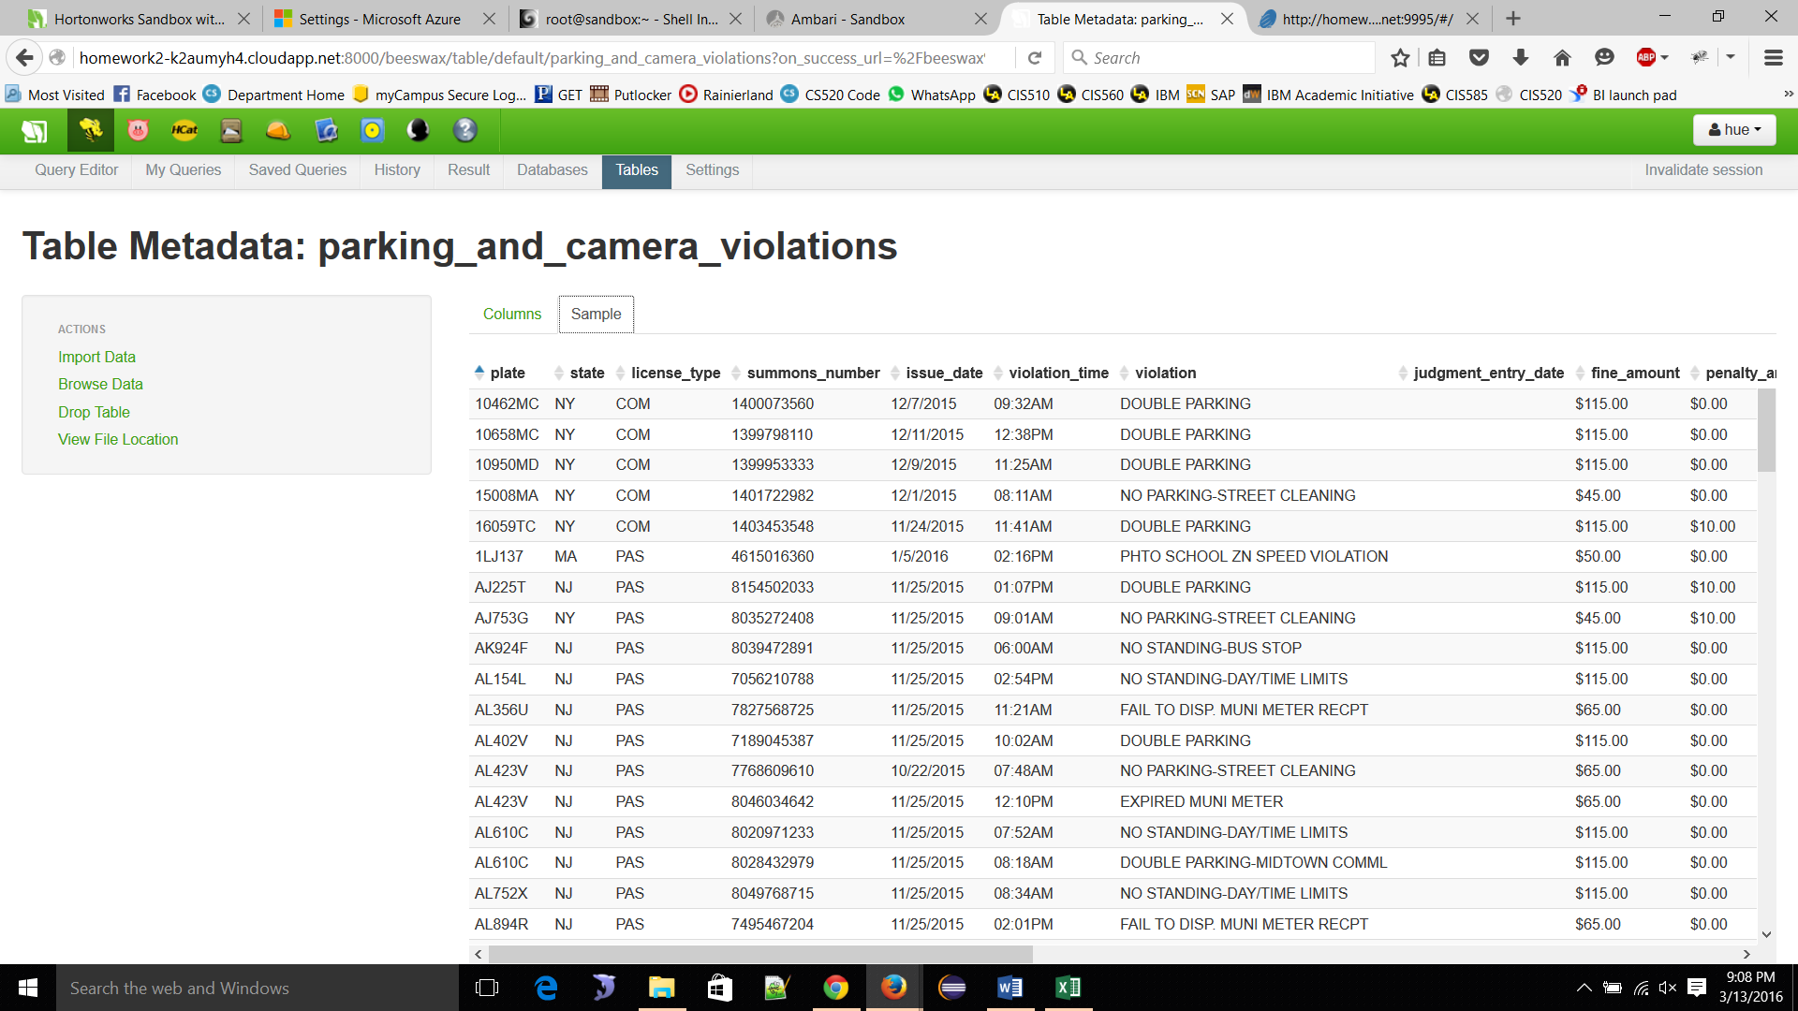
Tables

Slide 11
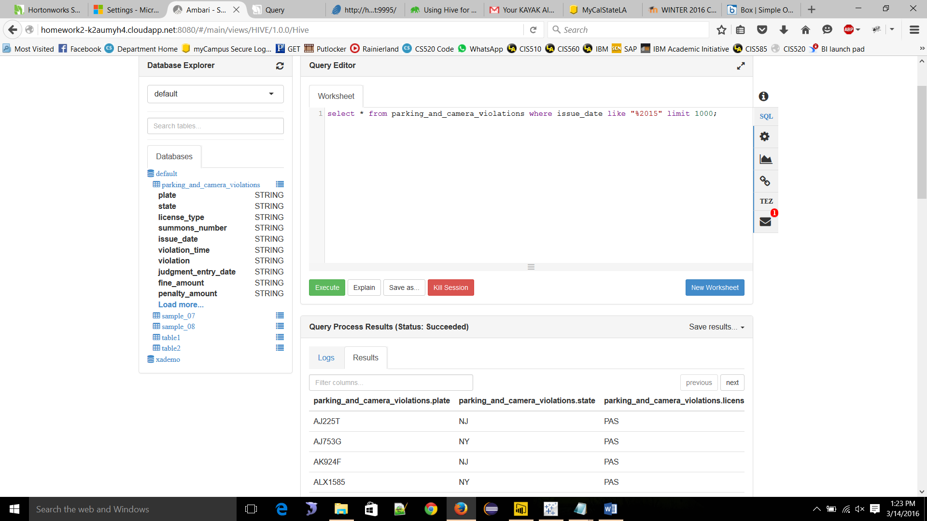
Query editor in Ambari

Slide 12
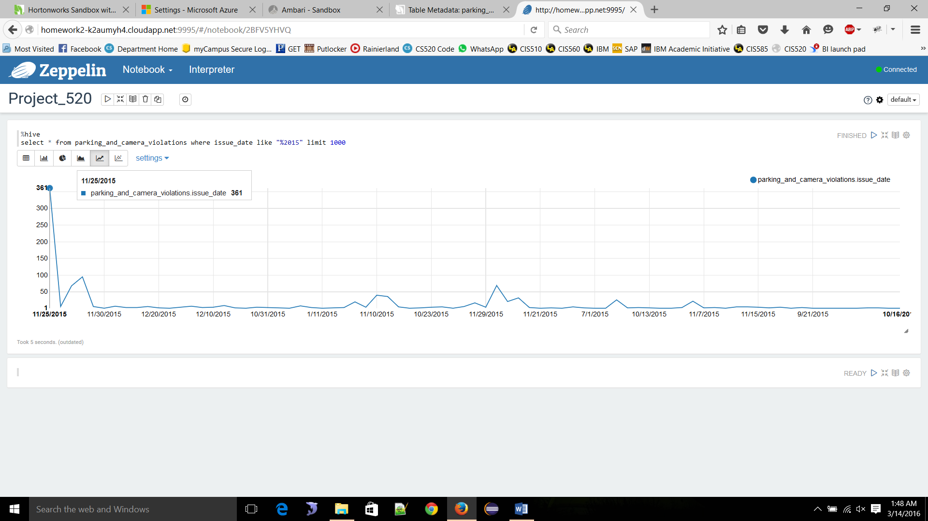
Violation Issue Dates

Slide 13
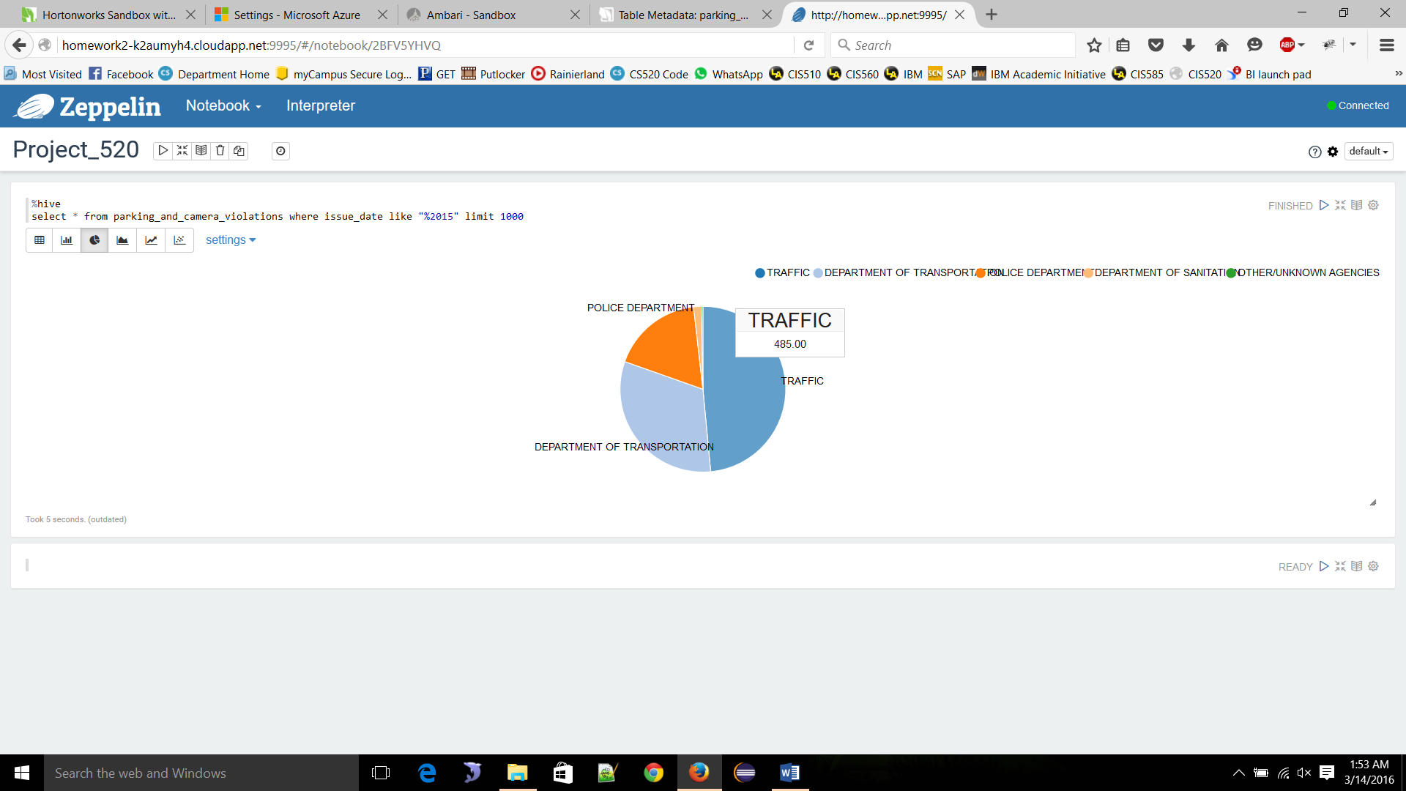
Ticket issuing Dept.

Slide 14
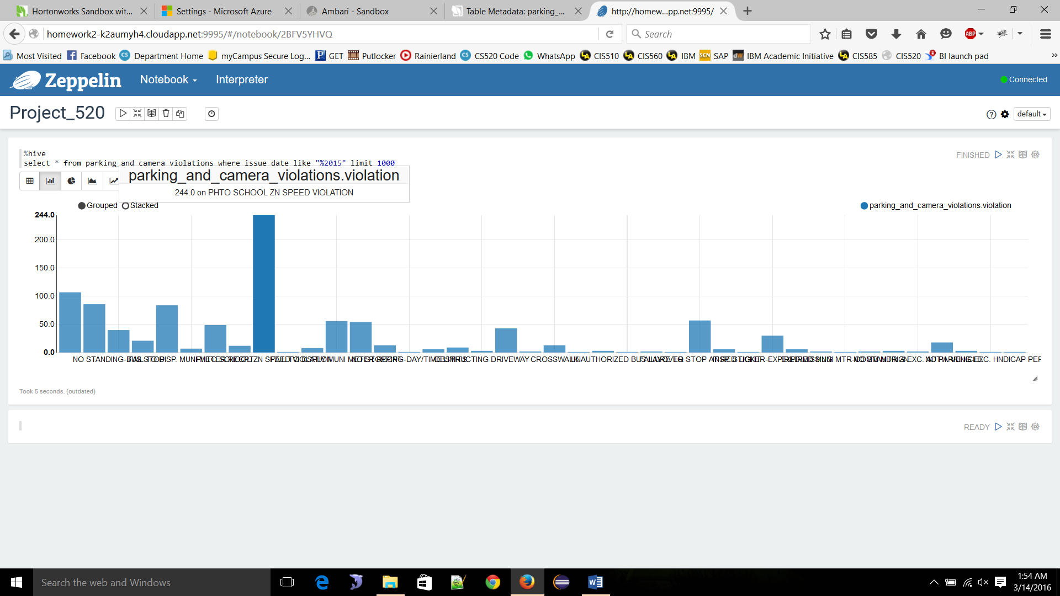
Violation Types

Slide 15
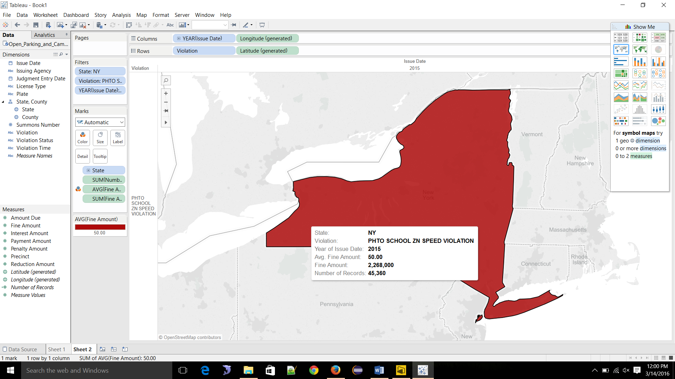
Visualization

Slide 16
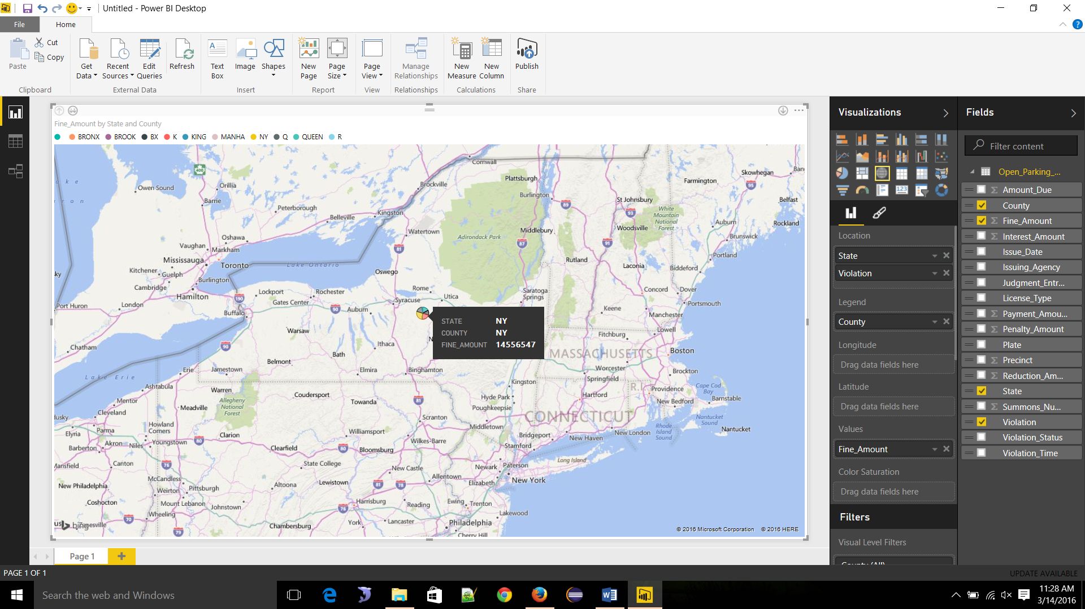
Visualization Cont.

Slide 17
Conclusion
Summing up all the work and generating a Data visualization out of the Unstructured data which will eventually give a discern view and help the public safety department of NY State to tackle Such Violations or enforce better management solutions to the particular concentrated area of high Parking Violations .

Slide 18
References
[1] https://data.cityofnewyork.us/City-Government/Open-Parking-and-Camera-Violations/nc67-uf89
[2] https://portal.azure.com/#resource/subscriptions/49187439-970f-4c14-ba28-b945239fda34/resourceGroups/Group-1/providers/Microsoft.ClassicCompute/virtualMachines/homework2
[3] http://homework2-k2aumyh4.cloudapp.net:8888/
[4] http://homework2-k2aumyh4.cloudapp.net:4200/
[5] http://homework2-k2aumyh4.cloudapp.net:8080/#/main/dashboard/metrics
[6] http://homework2-k2aumyh4.cloudapp.net:8000/about/
[7] http://homework2-k2aumyh4.cloudapp.net:9995/#/

Slide 19
Thank You !!

